Slide 1
CS 589 Fall 2021 Lecture 2
Probability ranking principle
Probability retrieval models
Monday 6:30-9:00
Babbio 122
All zoom links in Canvas
photo: https://www.scubedstudios.com/information-retrieval/
Notes:
In this lecture, we will be talking about probabilistic ranking models, which is

Slide 2
A Brief History of IR
1958
Cranfield evaluation methodology; word-based indexing
300 BC
1960s
building IR systems on computers; relevance feedback
Callimachus: the first library catalog
1970s
TF-IDF; probability ranking principle
1980s
TREC; learning to rank; latent semantic indexing
1950s
1990 - now
web search; supporting natural language queries;
Punch cards, searching at 600 cards/min
Notes:
In today’s lecture, we will be talking about probabilistic ranking principle, and probabilistic retrieval models such as the BM25 model, which was first introduced in the 1970s. BM25 was a ranking model based on probabilistic theory. As of today, it’s still one of the most major ranking models that people would choose to implement for their systems, due to its simplicity and competitive performance.

Slide 3
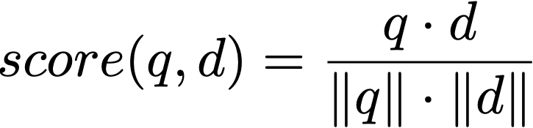
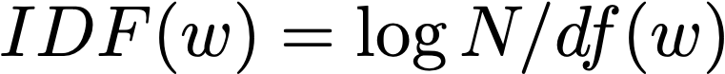
Review of Lecture 1: Vector-Space model
Vector space model:
TF-IDF weighting:
Notes:
Before we begin today’s lecture, let’s first review what we learned from the last lecture. We learned that each document and each query can be represented as a vector in the same space. To retrieve a document from a query, we compute the similarity score as the dot product between the document and query vector. It is important to leverage the inverse document frequency to penalize the weight of stop words such as “the” and “a”.

Slide 4
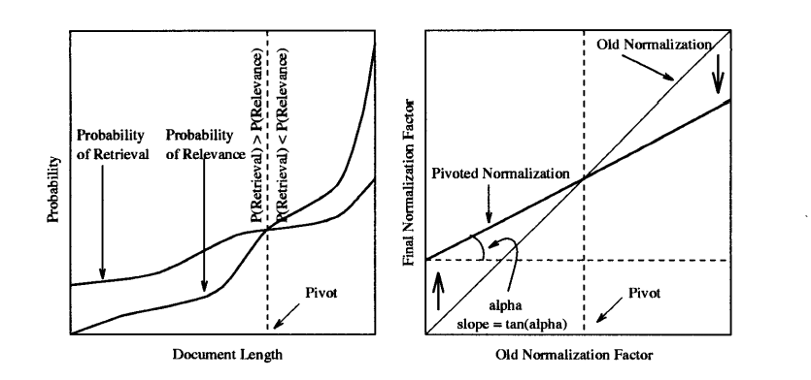
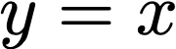
Document length pivoting
Rotate the relevance score curve, such that it most closely align with the relevance judgement curve
Pivoted Document Length Normalization: http://singhal.info/pivoted-dln.pdf
Notes:
creates the building block of more advanced techniques

Slide 5
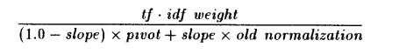
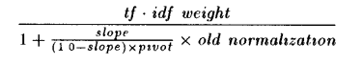
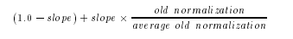
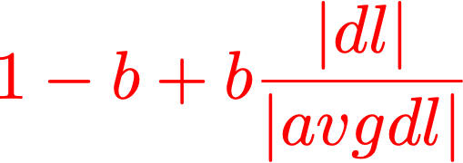
Document length pivoting
Rotate the relevance score curve, such that it most closely align with the relevance judgement curve
fixing pivot to avgdl
standard formulation for doc length normalization
Pivoted Document Length Normalization: http://singhal.info/pivoted-dln.pdf
Notes:
It’ll be nice if the pivot can be a fixed constant so we don’t have to worry about changing it.

Slide 6
Pop quiz
Suppose we have one query and two documents:
If we use the vector space model without IDF, which document has the highest and the lowest score?
d1, d2
d1, d3
d3, d1
d3, d2
q = “covid 19”
d1 = “covid patient”
d2 = “19 99 car wash”
d3 = “19 street covid testing facility is reopened next week”
Notes:
we use Google playstore data as the data source, so we collect these data, we clean it, we split the sentence, and we build a filtering algorithm to select the high quality sentence

Slide 7
Answer
Recall the VS model:
score(q, doc1) = 1/sqrt(2)/sqrt(2) = 0.4999, score(q, doc2) = 1/sqrt(2)/sqrt(4) = 0.3535, score(q, doc3) = 2/sqrt(2)/sqrt(9) = 0.4714
Therefore the answer is C: doc1 > doc3 > doc2
q = “covid 19”
doc1 = “covid patient”
doc2 = “19 99 car wash”
doc3 = “19 street covid testing facility is reopen next week”
Notes:
we use Google playstore data as the data source, so we collect these data, we clean it, we split the sentence, and we build a filtering algorithm to select the high quality sentence

Slide 8
Lecture 2
Review of fundamentals in stats
Random variables, Bayes rules, maximum likelihood estimation
Probabilistic ranking principle
Probability retrieval models
Model 1: Robertson & Spark Jones model (RSJ model)
Model 2: BM25 model
Model 3: Language model based retrieval model
Notes:
In today’s lecture, we will first review some fundamentals in statistics, then talk about the retrieval model. In particular, we will learn the probabilistic ranking principle, which is how to rank documents based on the probability for each document to be relevant to the query. Next we will learn 3 retrieval models based on the probability ranking principle.

Slide 9


Random variables
Random variables: biased coin
sequence = 0, 1, 0, 0, 1, 1, 0, 1, 0, 1, 0, 0
Observation
Bernoulli distribution:
seq
Parameter:
Notes:
If you have taken stats class such as MATH 222, you should have learned fundamentals of random variables.
For example, an unbiased coin is a random variable. We can repeatedly toss an unbiased coin, so that we can observe a sequence of the results, where 0 represents facing up and 1 represents facing down. When can assume an underlying distribution behind how this sequence has happened.
In this sequence, each outcome of the coin toss is an independent event of any other outcome. For each event, there exists a parameter named alpha, alpha is the probability for the coin to face up. And this distribution is called the Bernoulli distribution. Here is a graphical model for the Bernoulli distribution.

Slide 10
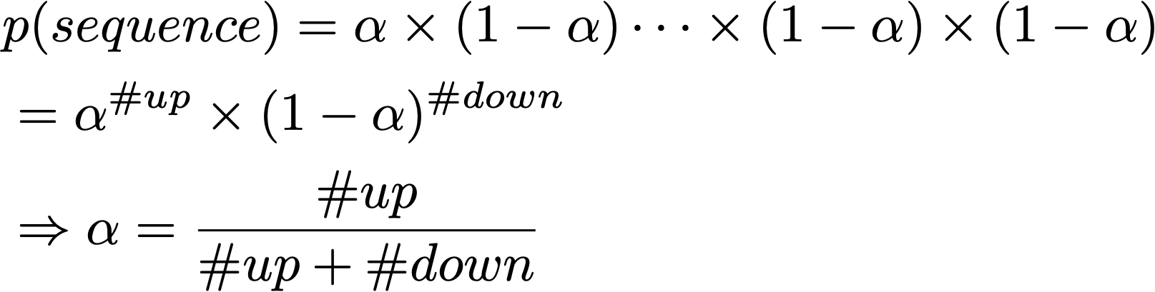
Random variables
Random variables: unbiased coin
sequence = 0, 1, 0, 0, 1, 1, 0, 1, 0, 1, 0, 0
Observation
Bernoulli distribution:
seq
Maximum likelihood estimation
Notes:
Because each event is independent, the probability for the sequence to happen is a joint probability which is the product of the probability for each outcome.
As a result, we can estimate a unique value for the parameter alpha such that the probability p(sequence) is maximized, which is exactly the proportion of ups. This estimation process is called a maximum likelihood estimation.

Slide 11
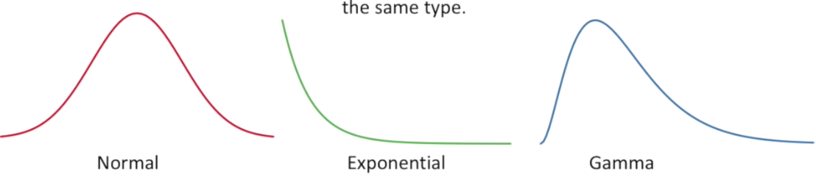
Maximum likelihood estimation
Fitting a distribution model to the data
Assumes mouse weights follow an underlying distribution
Notes:
For the coin toss problem, the Bernoulli model is the right choice and it’s hard to think of any other models that works better.
For other problems however, we may need to decide what’s the right stats model. For example, when estimating the weights of a group of mice, it is possible the underlying distribution is normal, or exponential, or even Gamma. Without knowing the exact model. When selecting which model to choose for estimating the probability, an important factor is the difficulty in parameter estimation. We will see more examples later on.

Slide 12
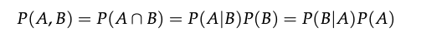
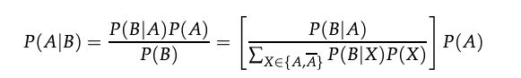
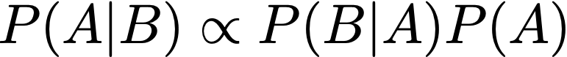
Bayes’ rules
Chain rule:
joint distribution
Bayes’ rule:
posterior
likelihood
prior
Notes:
Next let’s review the Bayes’ rules. The chain rule says the join probability of two event A and B to happen is equal to the…
If we divide both side by P(B), we can get the Bayes rule. The bases rule says the conditional probability …

Slide 13

Random variables in information retrieval
query = “artificial intelligence”
rel = 0, 1, 0, 0, 0, 0, 0, 0
d = artificial, intelligence, machine, intelligence, information, retrieval
q = artificial, intelligence
Notations: in future slides, q denotes the query, d denotes the document, rel denotes the relevance judgment
Notes:
In the next few slides, we will be introducing the probabilitic ranking principle for retrieval models. There are three random variables in information retrieval: the query, the document and the binary value of relevance judgement. For example, we can rank the documents based on the probability for each document to be relevant, conditioned on the query we have observed
In future we will use the following notations:

Slide 14
Random variables in information retrieval
query = “artificial intelligence”
rel = 0, 1, 0, 0, 0, 0, 0, 0
d = artificial, intelligence, machine, intelligence, information, retrieval
d = 56, 100, 120, 100, 50, 221
q = artificial, intelligence
q = 56, 100
Observation
Notations: in future slides, q denotes the query, d denotes the document, rel denotes the relevance judgment
Notes:
we use Google playstore data as the data source, so we collect these data, we clean it, we split the sentence, and we build a filtering algorithm to select the high quality sentence

Slide 15
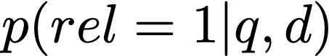
Probability ranking principle
Assume documents are labelled by 0/1 labels (i.e., the relevance judgement is either 0 or 1), given query q, documents should be ranked on their probabilities of relevance (van Rijsbergen 1979):
Theorem. The PRP is optimal, in the sense that it minimizes the expected loss (Ripley 1996)
PRP: rank documents by
Notes:
The probability ranking principle says that we can rank the documents by the probability for observing relevance = 1 given the document and the query.
There is a theorem which says

Slide 16
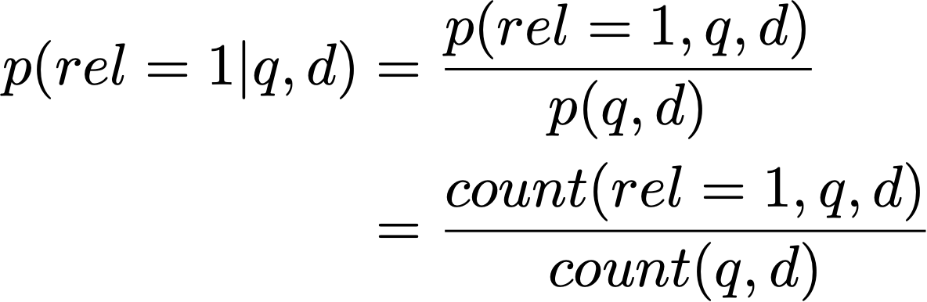
Estimating
Problems with this estimation?
not enough data
cannot adapt to new q
Bayes rule
Notes:
How to estimate p(rel=1|q,d)? Remember how we estimated the probability for the coin to face up, we can use a similar approach to estimate the conditional distribution, which is to leverage the counts.
For this sparsity problem, Instead we can leverage the Bayes rule and rewrite the probability. Why does this formulation solve the sparsity problem?

Slide 17
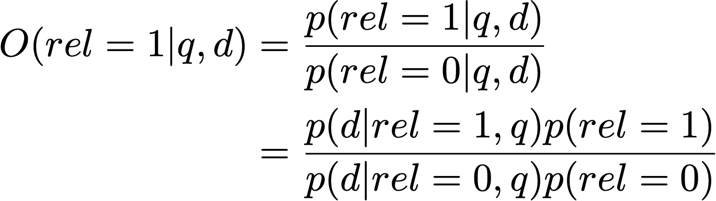
Estimating
odds
Notes:
Because ranking preserves order, we can rewrite the ranking score as the odds instead of the absolute probability. And we can ignore this part because it doesn’t rely on the document d.

Slide 18
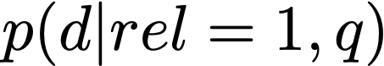

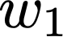
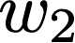
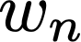


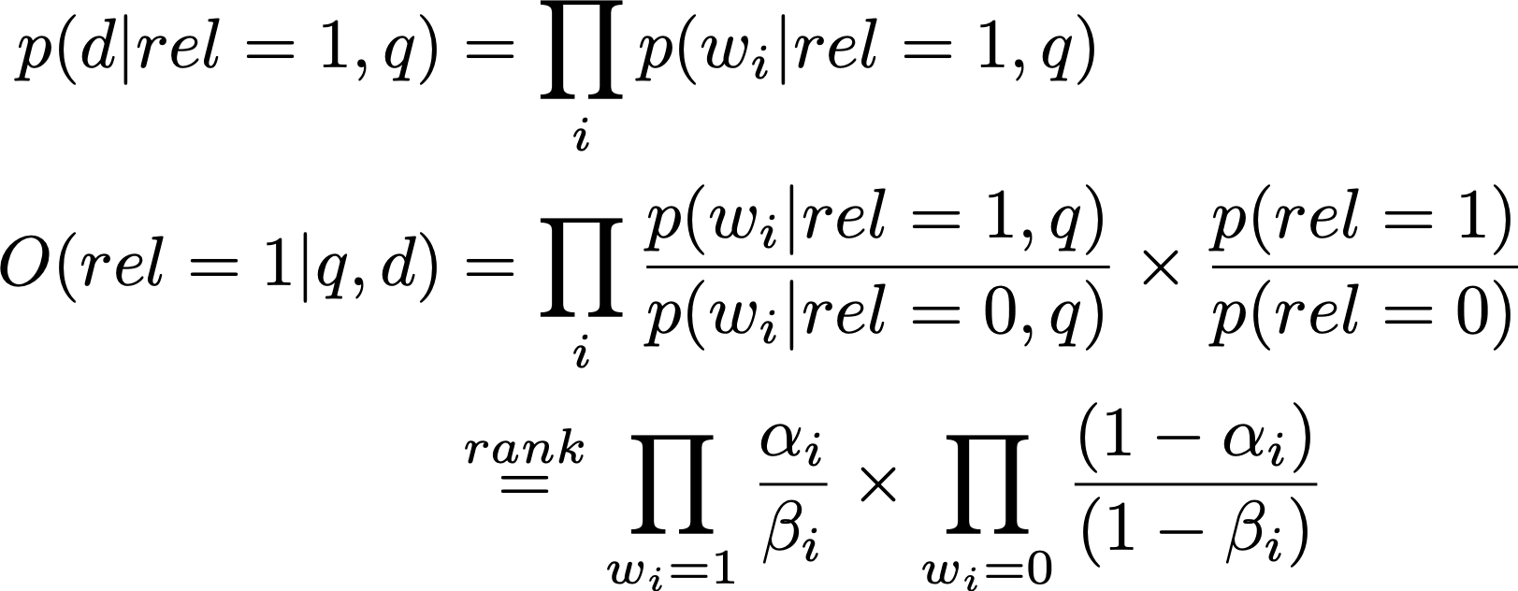
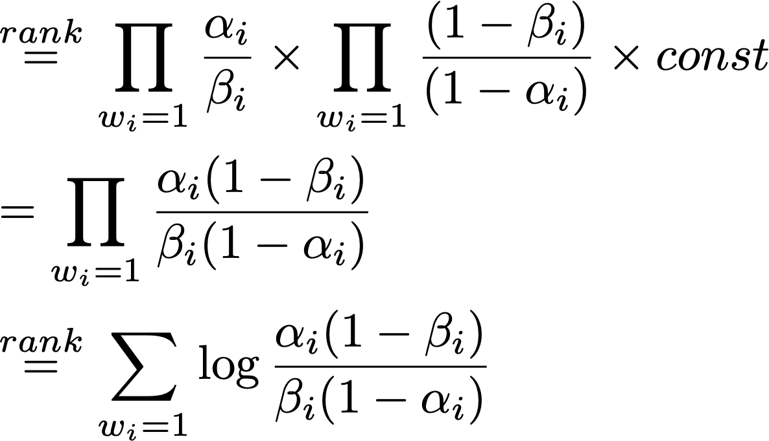
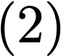

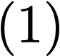
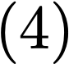
Estimating the generative model
…
i.i.d assumption
Notes:
Next we can derive

Slide 19
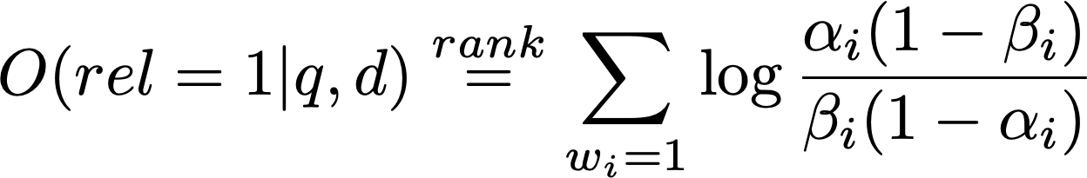
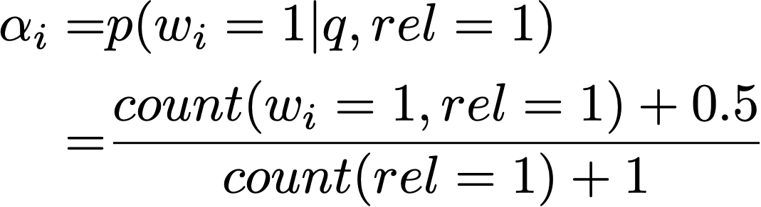
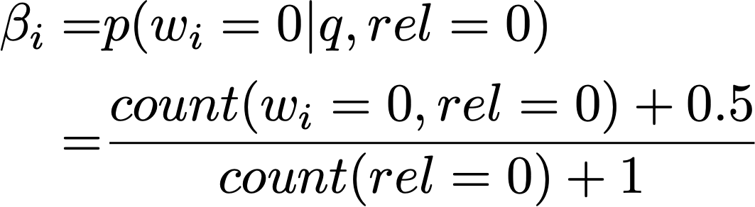
Model 1: RSJ model
(Robertson & Sparck Jones 76)
Probability for a word to appear in a relevant doc
Probability for a word to appear in a non-relevant doc
Notes:
This model is called the Robertson and spark jones model. We can estimate the parameter alpha and beta according to the count of words.
Notice here wi is a binary variable, therefore we can only differentiate between whether or not a word has appeared in the document, if it has appeared for twice or more we cannot tell between those cases.

Slide 20
RSJ model: Summary
Uses only binary word occurrence (binary inference model), does not leverage TF information
RSJ model was designed for retrieving short text and abstract!
Requires relevance judgment
No-relevance judgment version: [Croft & Harper 79]
Performance is not as good as tuned vector-space model
How to improve RSJ based on these desiderata?
Notes:
RSJ model requires the relevance judgment. We have to know whether or not a document is relevant.
With those disadvantages, the empirical performance of RSJ is

Slide 21
Desiderata of retrieval models
Recall the desiderata of a retrieval models:
The importance of TF is sub-linear
Penalizing term with large document frequency using IDF
Pivot length normalization
How to improve RSJ based on these desiderata?
Notes:
we use Google playstore data as the data source, so we collect these data, we clean it, we split the sentence, and we build a filtering algorithm to select the high quality sentence

Slide 22
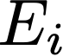
Model 2: Okapi/BM25
Introduced in 1994
SOTA non-learning retrieval model
Estimate probability using eliteness
Hidden variable between each document-term pair
A document-term pair is elite if the document is about the concept denoted by the term, e.g., for “artificial intelligence”, an elite word is “learning”
Eliteness is binary
Term occurrence depends on eliteness
eliteness
Notes:
we use Google playstore data as the data source, so we collect these data, we clean it, we split the sentence, and we build a filtering algorithm to select the high quality sentence

Slide 23
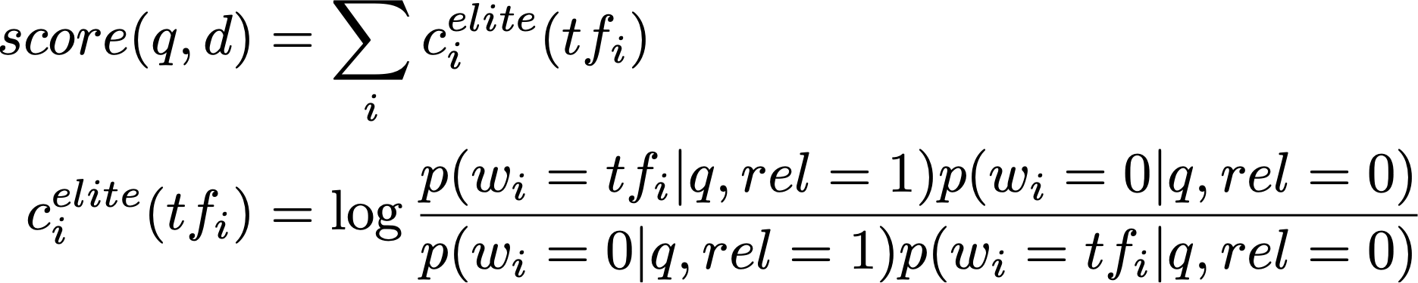
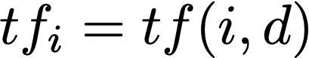
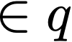
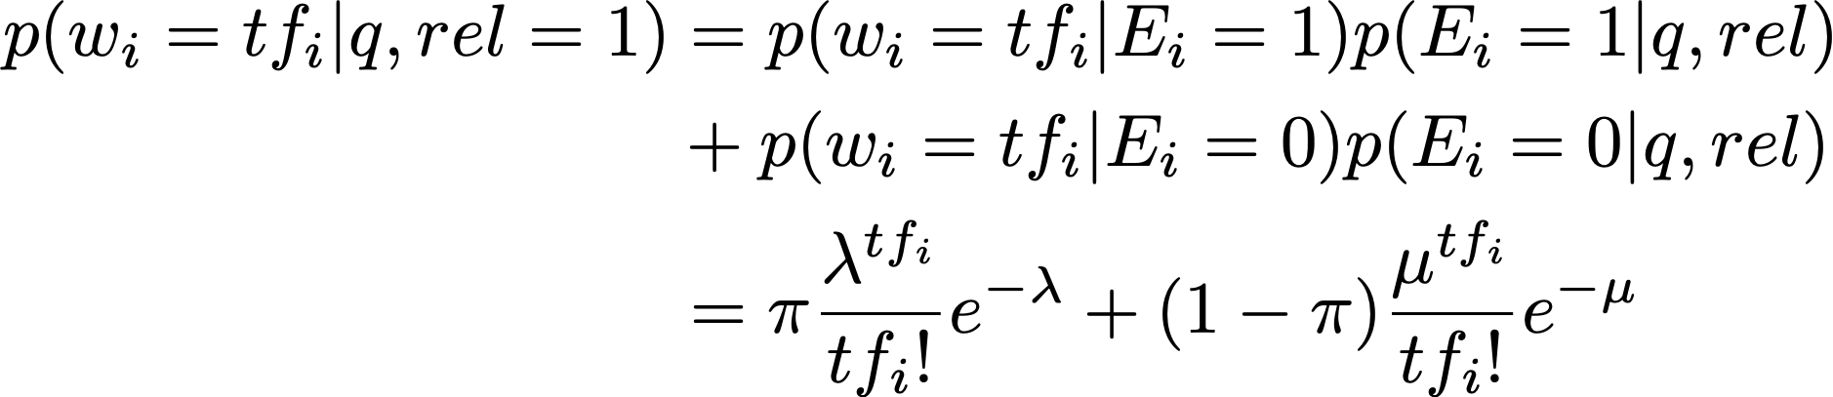
Okapi/BM25
RSJ model
extend
eliteness
(2 Poisson model)
Notes:
We estimate the probability conditioned on this eliteness variable

Slide 24
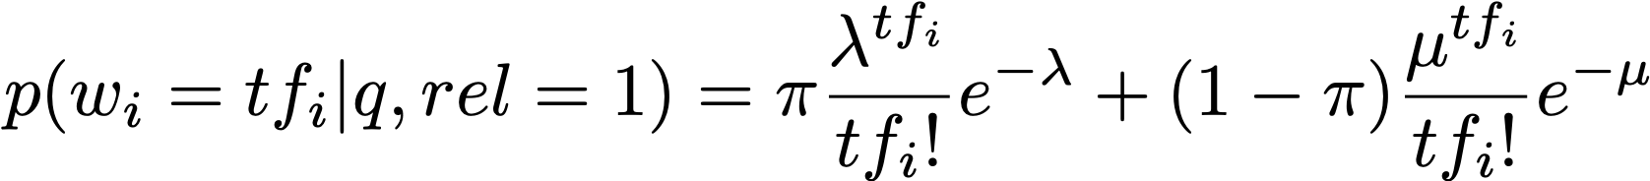
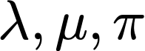
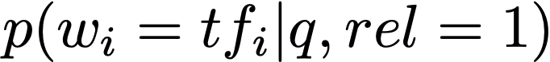
Okapi/BM25
We do not know
MLE for ? Difficulty to estimate
Designing a parameter-free model such that it simulates
Notes:
How to estimate lambda mu and pi in the 2 poisson model?

Slide 25
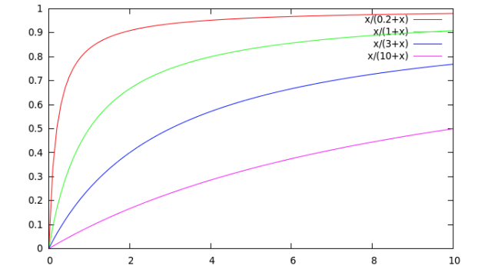
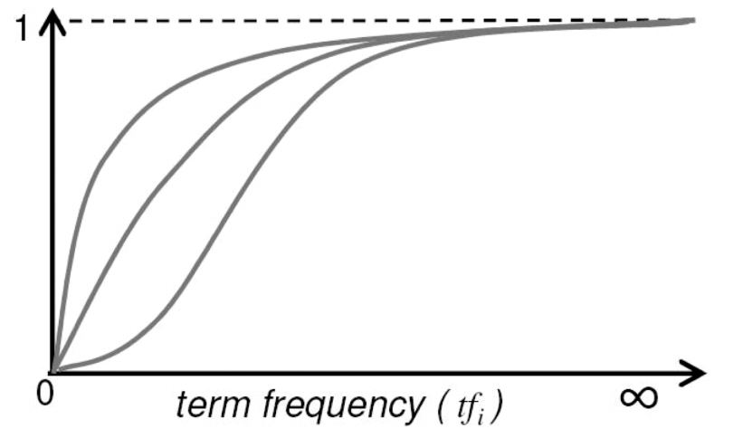
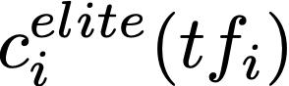
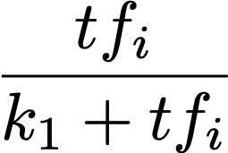
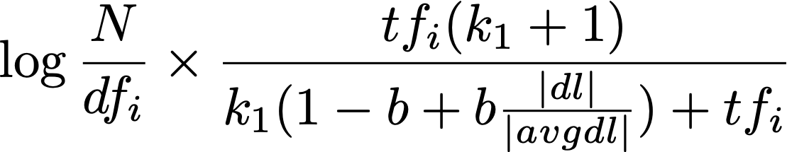
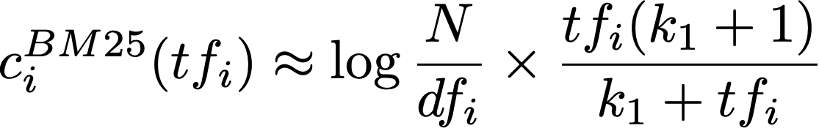
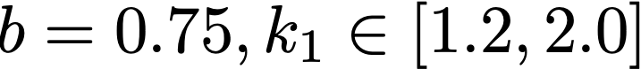
Simulating the 2-Poisson model
slide credit: Stanford CS276 Information retrieval
Notes:
The BM25 model has plotted the elite score and it looks like this curve is very similar to this simple formula, so they decided to use this formulation along with the IDF term and the pivoted length normalization term. The final formulation is

Slide 26
Analysis of BM25 formulation
IDF
Pivoted document length normalization
Notes:
The BM25 model has plotted the elite score and it looks like this curve is very similar to this simple formula, so they decided to use this formulation along with the IDF term and the pivoted length normalization term. The final formulation is

Slide 27
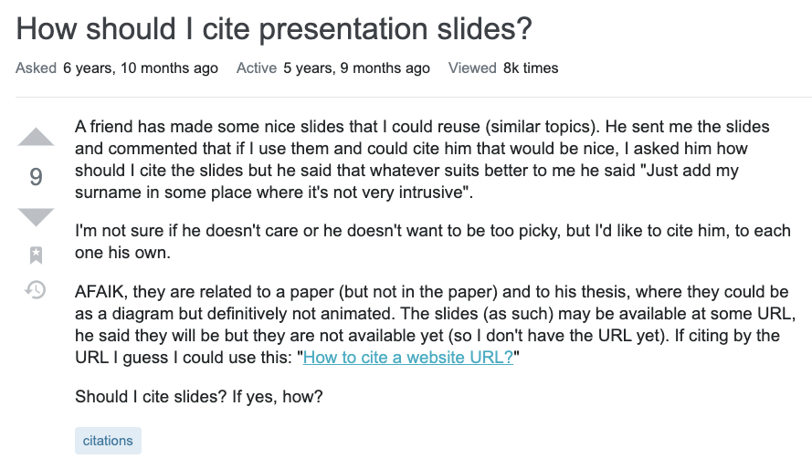
Multi-field retrieval
title
question
Notes:
we use Google playstore data as the data source, so we collect these data, we clean it, we split the sentence, and we build a filtering algorithm to select the high quality sentence

Slide 28
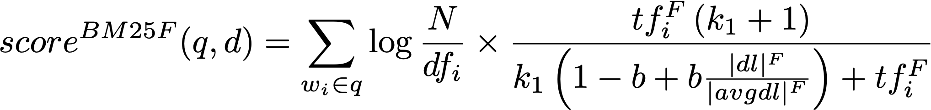
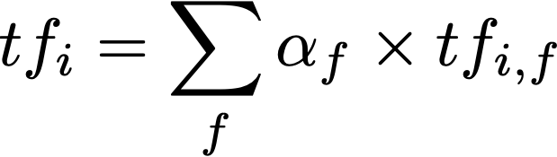
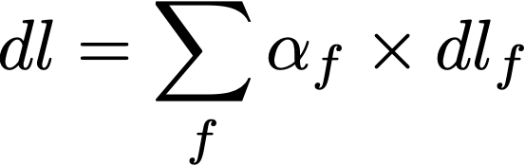
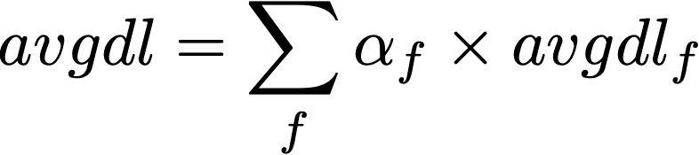
BM25F
Each variable is estimated as the weighted sum of its field value
alpha_f: hyper parameters
Notes:
we use Google playstore data as the data source, so we collect these data, we clean it, we split the sentence, and we build a filtering algorithm to select the high quality sentence

Slide 29
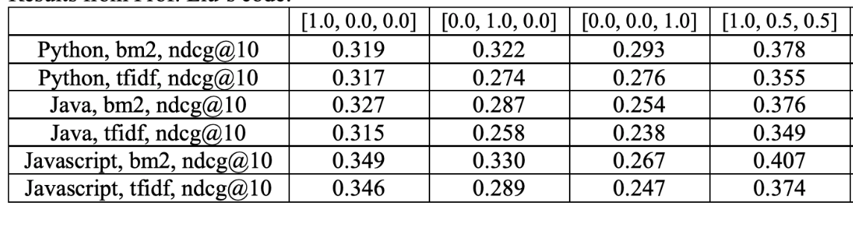
Multi-field retrieval
HW1: BM25 outperforms TF-IDF in every field & combined
Notes:
we use Google playstore data as the data source, so we collect these data, we clean it, we split the sentence, and we build a filtering algorithm to select the high quality sentence

Slide 30

Analysis on the n-Poisson model
Advantage: BM25 is based on the 2-Poisson model
A document-term pair is elite if the document is about the concept denoted by the term
Disadvantages:
For unigram term, documents will not fall cleanly into elite/non-elite set
For term with multiple tokens, requires a combinatorial explosion of elite set
Requires explicit indexing of the ‘elite’ words
Notes:
we use Google playstore data as the data source, so we collect these data, we clean it, we split the sentence, and we build a filtering algorithm to select the high quality sentence

Slide 31
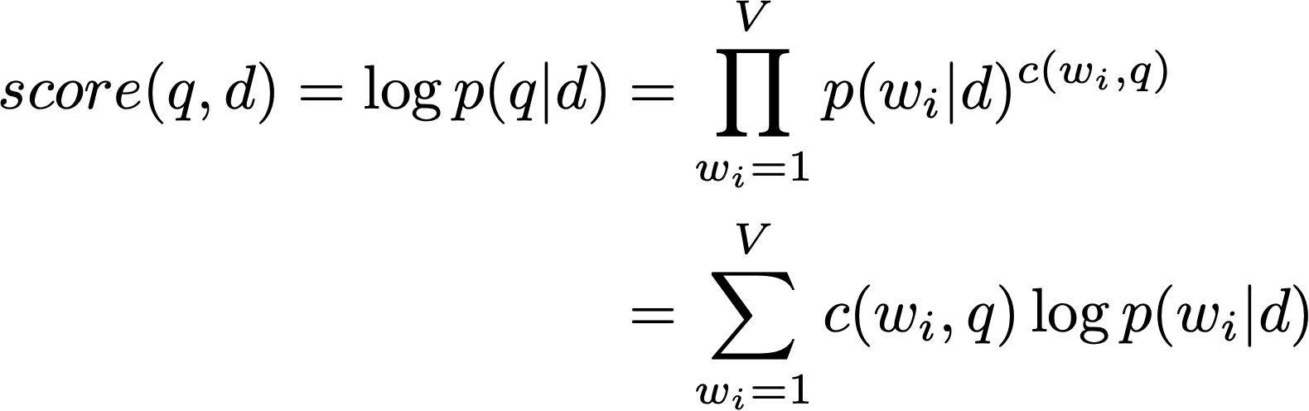


Model 3: Language model-based retrieval
A language model-based retrieval method [Ponte and Croft, 1998]
Bernoulli -> multinomial
corpus unigram LM
Notes:
Notice the formulation of language model based retrieval model is different from the models we derived using PRP, why?
We can estimate p(wi|d) with different cases. If the word is seen in the document,

Slide 32
Language model-based retrieval
BM25
Language model
Notes:
we use Google playstore data as the data source, so we collect these data, we clean it, we split the sentence, and we build a filtering algorithm to select the high quality sentence

Slide 33




Language model-based retrieval
. . .
constant
Notes:
we use Google playstore data as the data source, so we collect these data, we clean it, we split the sentence, and we build a filtering algorithm to select the high quality sentence

Slide 34

Different senses of ‘model’ [Ponte and Croft, 98]
First sense (high level): an abstraction of the retrieval task itself
Second sense (mid level): modeling the distribution, e.g., 2-Poisson model
Thirds sense (low level): which statistical language model is used in
decouple
+
retrieval model
other problems (e.g., indexing)
Notes:
we use Google playstore data as the data source, so we collect these data, we clean it, we split the sentence, and we build a filtering algorithm to select the high quality sentence

Slide 35


Statistical language model
A probability distribution over word sequences
p(“Today is Wednesday”) ≈ 0.001
p(“Today Wednesday is”) ≈ 0.0000000000001
p(“The eigenvalue is positive”) ≈ 0.00001
Unigram language model
Generate text by generating each word INDEPENDENTLY
Thus, p(w₁ w₂ ... w_{n})=p(w₁)p(w₂)…p(w_{n})
Parameters: {p(t_{i})} p(t₁)+…+p(t_{N})=1 (N is voc. size)
Notes:
we use Google playstore data as the data source, so we collect these data, we clean it, we split the sentence, and we build a filtering algorithm to select the high quality sentence

Slide 36
Notes on language model-based retrieval
Advantages:
Avoided the disadvantages in eliteness
Defines a general framework, more accurate can further improve the model
In some cases, has outperformed BM25
Disadvantages:
The assumed equivalence between query and document is unrealistic
Only studied unigram language model
Performance is not always good
Notes:
we use Google playstore data as the data source, so we collect these data, we clean it, we split the sentence, and we build a filtering algorithm to select the high quality sentence

Slide 37





Equivalence to KL-divergence retrieval model
Kullback-Leibler divergence
. . .
smoothed
constant
why not the opposite?
(Eq. 1)
Notes on the KL-divergence retrieval formula and Dirichlet prior smoothing
Notes:
we use Google playstore data as the data source, so we collect these data, we clean it, we split the sentence, and we build a filtering algorithm to select the high quality sentence

Slide 38




Estimating
Estimating based on the maximum likelihood estimation
Disadvantage: if the word is unseen, probability will be 0
Solution: language model smoothing:
(plug in Eq. 1)
Dirichlet smoothing
corpus unigram LM
Notes:
we use Google playstore data as the data source, so we collect these data, we clean it, we split the sentence, and we build a filtering algorithm to select the high quality sentence

Slide 39

Estimating
Dirichlet smoothing
Jelinek-Mercer smoothing
Notes:
we use Google playstore data as the data source, so we collect these data, we clean it, we split the sentence, and we build a filtering algorithm to select the high quality sentence

Slide 40
Other smoothing methods
Additive smoothing
Good-Turing smoothing
Absolute discounting
Kneser-ney smoothing
Notes:
we use Google playstore data as the data source, so we collect these data, we clean it, we split the sentence, and we build a filtering algorithm to select the high quality sentence

Slide 41



Tuning parameters in smoothing models [Zhai and Lafferty 02]
Tuning parameter using “leave-one-out” method
Estimating parameter using Newton’s method (2nd derivative)
remove
Two-stage language models for information retrieval
Notes:
we use Google playstore data as the data source, so we collect these data, we clean it, we split the sentence, and we build a filtering algorithm to select the high quality sentence

Slide 42




Tuning parameters in smoothing models [Zhai and Lafferty 02]
Tuning parameter using MLE for the query probability
Expectation-Maximization algorithm:
Two-stage language models for information retrieval
Notes:
we use Google playstore data as the data source, so we collect these data, we clean it, we split the sentence, and we build a filtering algorithm to select the high quality sentence

Slide 43

Feedback language model [Zhai and Lafferty 01]
Model-based feedback in the language modeling approach to information retrieval
Notes:
we use Google playstore data as the data source, so we collect these data, we clean it, we split the sentence, and we build a filtering algorithm to select the high quality sentence

Slide 44







Feedback language model [Zhai and Lafferty 01]
sparsity
get document model
retrieve
infer w/ EM algo
Model-based feedback in the language modeling approach to information retrieval
Notes:
we use Google playstore data as the data source, so we collect these data, we clean it, we split the sentence, and we build a filtering algorithm to select the high quality sentence

Slide 45

Evaluation on smoothing methods [Zhai & Lafferty 02]
Two-stage language models for information retrieval
Notes:
we use Google playstore data as the data source, so we collect these data, we clean it, we split the sentence, and we build a filtering algorithm to select the high quality sentence

Slide 46

Evaluation on smoothing methods [Zhai & Lafferty 01b]
A Comparative Study of Probabilistic and Language Models for Information Retrieval
Notes:
we use Google playstore data as the data source, so we collect these data, we clean it, we split the sentence, and we build a filtering algorithm to select the high quality sentence

Slide 47

Comparison between BM25 and LM [Bennett et al. 2008]
However, BM25 outperforms LM in other cases
A Comparative Study of Probabilistic and Language Models for Information Retrieval
Notes:
we use Google playstore data as the data source, so we collect these data, we clean it, we split the sentence, and we build a filtering algorithm to select the high quality sentence

Slide 48
Summary on Hyperparameter tuning
RSJ: no parameter
BM25: Due to the formulation of two-Poisson, parameters are difficult to estimate, so use a parameter free version to replace it
Language model
Leave-one-out
EM algorithm
Notes:
we use Google playstore data as the data source, so we collect these data, we clean it, we split the sentence, and we build a filtering algorithm to select the high quality sentence

Slide 49


Translation-based language model [Xue et al. 2008]
The retrieval model can benefit from incorporating knowledge in the formulation
Translation matrix:
Retrieval Models for Question and Answer Archives
Notes:
we use Google playstore data as the data source, so we collect these data, we clean it, we split the sentence, and we build a filtering algorithm to select the high quality sentence

Slide 50
Discussion on query length
What if the query is very long?
For example, the query is a paragraph or a document
The problem of retrieval is turned into a matching problem
i.e., semantic matching
Notes:
we use Google playstore data as the data source, so we collect these data, we clean it, we split the sentence, and we build a filtering algorithm to select the high quality sentence

Slide 51

Deep semantic matching [Pang et al. 2016]
d
v1
v2
….
vm
w1
each cell:
distributed representation of words (word2vec)
w2
q
….
wn
A Study of MatchPyramid Models on Ad-hoc Retrieval
Notes:
we use Google playstore data as the data source, so we collect these data, we clean it, we split the sentence, and we build a filtering algorithm to select the high quality sentence

Slide 52
Homework 1
Homework 1 is released in Canvas:
Implementing TF-IDF and BM25 on the LinkSO dataset:
https://sit.instructure.com/courses/44342/assignments/218604
Notes:
creates the building block of more advanced techniques

